Slide 1
“Making it Real” The Discovery of Agile Primary Care
The HC&V Crew

Slide 2
…Necessity is the Mother of Invention & it’s Father is creativity!... It’s been a busy year!

Slide 3
The Disruptor
Shortly before any lock down press briefing.…
Phone rings...
“We have a GP who’s been in contact with a positive corona case, they need to self-isolate…immediately...and continue to see patients as if they were in surgery…also immediately”
We’re sure it sounds familiar!
This was the first time we really got an understanding of what was going to happen

Slide 4
The Disrupter (again)
For all the right reasons, the PM goes on TV and tells everyone to work from home…
Within 5 mins phones are ringing with confirmation that practice staff are been told to work from home the next day, and that we need to provide the IT enabler to support this…from the next day...
Possibly the longest lasting Disrupter and Driver for rapid change we (hopefully) ever see
It’s certainly up there with the biggest challenge we’ll ever face

Slide 5
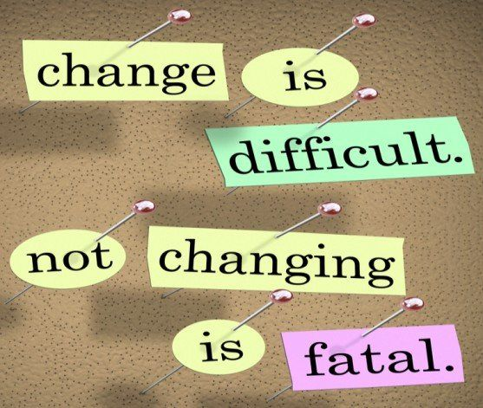

Slide 6
Why was this a Problem
Change is difficult (painful)
For years Primary Care has operated a similar access model
‘IT’ did what it needed to do, support a facility for patients to visit their GP (in the main)
‘IT’ seemed only to become of interest if it didn’t work (sweeping generalisation)
Money is tight so a focus on cheaper desktops rather than laptops has always been required for the majority of staff
IT\Digital may have tried to make key changes over the years, but frequently we were the wrong Disruptor…
Although this did mean that we had a few tricks up our sleeves
Change is difficult and if it isn’t broken then why fix it??? #Perception

Slide 7
Tackling the Challenge
Serious disrupter
The need was Urgent Tactical, not long term Strategic
Who fully understands the challenges impacting a practice.
Who lives and breaths it every single day
Who understands practice operational flow
Who understands the needs of the patients best
Is it:
The Digital Lead
NHSE
The Clinicians and the practice teams

Slide 8
Asking the Right Questions (The Importance of Clinical Champions)
We were at crises point… but we had our Digital GP Champions on hand
The Questions we asked were:
What do you need right now?
Why?
Does it exist?
The answers that came back were broadly:
The ability for clinical and admin staff to work from anywhere
The ability to provide remote consultations
To keep our staff and the public as safe as possible & to reduce demand ASAP

Slide 9
The Ability to Work Anywhere
Where possible we needed to move from desktops to laptops
All new stock from China was placed in 10 week quarantine and the whole country all of a sudden needed laptops
All existing kit available plus any orders we could secure was mobilised rapidly
Devices needed to be functional not top of the range
Call made to Green World – 300 working laptops to Humber on the way – week 1
Work in North Yorkshire & York to mobilise any and all stock held – week 1
In following weeks - NHSE found a warehouse of laptops we could take ownership of
1000 VPN tokens ordered and we maximised existing RAS investment
This meant that any laptop or DESKTOP could be used from any Internet connection
Very rapid agile mobilisation
Access to clinical systems was improved
Not only could systems be accessed on newly agile devices but we also
Made sure that access to mobile versions of clinical systems (EMIS & S1) could be downloaded on personal devices
We took part in the pilot of Internet Facing Version of S1 – extra choice….even had it working on a Mac
Almost overnight we moved from a fixed and static Primary Care workforce to a home working agile dynamo

Slide 10
Remote Consultations
Our Clinical Champions were very clear on this
accuRx is the best solution for us
It’s easy to use
It fits into clinical workflow
It integrates with S1 and EMIS (So a standard approach)
It works over SMS
We found out that it was easy to deploy
IT WAS FREE (for now)
We also found out that it met NHS Standards
By early April 100% of HCV practices had access to VC
For both VC and bulk comms SMS was worth it’s weight in gold
However the limitations of our existing procurement of OC solution did become apparent…

Slide 11
Personal Responsibility
There was no way that we could provide the training required to support all primary care staff to deliver this level of change
We needed practices to own some of the change – and the driver was right for this
We provided easy to follow guides for practice staff and expected them to self-support
This allowed us to support the exceptions

Slide 12
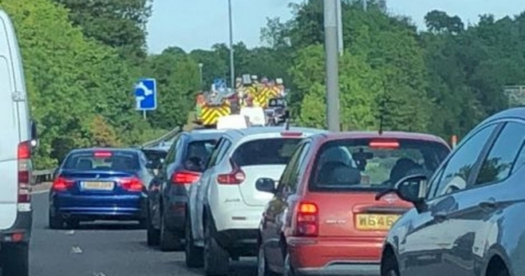
Boundaries of Primary Care
The removal of the dependency on 4 walls and ‘Face To Face’ removed a number of limitations on how Primary Care could be delivered
It meant that Primary Care could be delivered almost anywhere
Suddenly Primary Care can be delivered (in real time) to:
Care Homes
Hospices
The M62
Australia
Never before has Primary Care been so accessible

Slide 13
Boundaries of Primary Care
Change is hard, and the new accessibility brings business challenges to Primary Care
Suddenly Resources are in the wrong place
You end up with receptionists not being fully utilised, yet not enough patient triage workforce
This was genuinely unexpected, given everything else that was going on…
…and with it being so new finding SME’s isn’t straight forward

Slide 14
The “Illusion”
After COVID we have
An agile clinical workforce
Digital front doors
Care delivery at distance
Meetings that happen virtually
An ultra efficient workforce
But is it real…or a temporary illusion?
Primary COVID costs were funded out of GPIT (we didn’t know this at the time)
The COVID laptops now need to be repurposed as GPIT refresh devices….apart from they are still being used as COVID devices.
Licenses for some critical solutions were provided on a temporary basis
Software migrations (N365) are difficult with an agile workforce
Meetings are so easy we have even more of them – how many of us now have more than 30 hours of meetings per week as a ‘new norm’
It’s a different way of working – and the business change will \must catch up
People are starting to suffer from being away from office for long periods of time, and some of the efficiency gains are due to the ease and need to work 50 hours + a week as standard - A tired workforce

Slide 15
Making it ‘Real’
In some ways we have done the easy bit and now we have the difficult bit to deliver to a battle weary system with a workforce heading for burnout
The need to:
Ensure that devices ultimately end up in the right place and replace PCs not fit for purpose
Ensure long term financial structures are in place to adopt the appropriate COVID changes as permanent solutions
Ensure that the appropriate business change is in place
Ensure staff welfare is where it needs to be
Entrust the techies to sort out the kit, and find the funding to support them
Remember that we’ve never had such an appreciation by our user base, and to recognise this and grow it

Slide 16
What was delivered…
Over 1800 laptops to mobilise primary care delivery
Deployment of video consultation software to 100% primary care where this had never been used before
Rapid deployment of online consultation software to remaining practices
Provided input to national internet facing S1 pilots
Plenty of SOPs and guidance created and circulated for support with new ways of working
Over 1000 data enabled tablets to care homes to support video consultation in primary care
Confidence in the Digital Teams to gain momentum in strategic developments e.g. a shared HCV EPaCCS record & the YHCR

Slide 17
What’s next…
Manage contract variations due to swell in device numbers without undoing the good work
Reverse engineer the procurements…
Embed solutions introduced at pace…’at pace’
Maintain pace…
Influence the national data sharing solutions available now through COPI (Control of Patient Information) Regulations and make them last
NHS111 first enablement
Support the recovery our systems activity levels
Maintain pace…

Slide 18
What did we learn/re-learn?
The value of good colleagues
Patient centred care is definitely why we’re here
Don’t let perfect stand in the way of good
There will never be enough time
You cannot please everyone all of the time
IT and digital is categorically service critical – not just an ‘enabler’

